Slide 1
Protection of AI Inventions in Japan
Takeshi Iizuka Japan Patent Attorneys Association
International Activities Center

Slide 2
Disclaimer
The materials prepared and presented here reflect the personal views of the author and do not represent any other individuals or entities. Iizuka International Patent Office and Japan Patent Attorneys Association does not assume any responsibility for the materials.
It is understood that each case is fact specific and the materials are not intended to be a source of legal advice. These materials may or may not be relevant to any particular situation.
The author, Iizuka International Patent Office or Japan Patent Attorneys Association cannot be bound to the statements given in these materials. Although every attempt was made to ensure that these materials are accurate, errors or omissions may be contained therein and any liability is disclaimed.

Slide 3
Overview
Basics of AI (Machine Learning)
Tips for Protecting AI-Related Invention in Japan
Allowable Claim Category (Subject Matter)
Claims in Accordance with Business Model
System Incorporating a Machine Learning Unit as One of the Claim Elements
Others
Summary

Slide 4
Overview
Basics of AI (Machine Learning)
Tips for Protecting AI-Related Invention in Japan
Allowable Claim Category (Subject Matter)
Claims in Accordance with Business Model
System Incorporating a Machine Learning Unit as One of the Claim Elements
Others
Summary

Slide 5
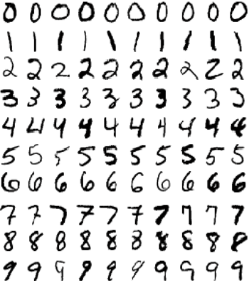
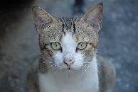
1. Basics of AI (Machine Learning)
Artificial Intelligence is a popular buzzword.
Current boom in AI is a boom in “Deep Learning.”
“Deep Learning” is a kind of neural network-based machine learning.
Artificial Intelligence
(Rule-Based AI)
Machine Learning
(Neural Network, Support Vector Machine, etc.)
Deep Learning
e.g. Recognition of
handwritten numbers
e.g. Recognition of images
1950
1980’
2010

Slide 6
1. Basics of AI (Machine Learning)
Basic learning process of neural network-based machine learning, including “Deep Learning” (Step 1 to Step 7.)
Step 7
Iteration
Step 6
Parameters updated
Input layer
Intermediate layer
Output layer
Step 5
Calculate Error
weight
weight
Error
Input Data
Teach Data
・・・
T
In
・・・
・・・
・・・
・・・
Step 1
Step 3
Step 4
Step 2
Output
Input
propagation
Teaching Signal

Slide 7
1. Basics of AI (Machine Learning)
There are two phases for machine learning:
(I) Training Phase
(II) Utilization Phase
In
In
Making a Trained Model
Utilizing a
Trained Model:
A set of node and
weight data
Iteration
・・・
・・・
・・・
・・・
・・・
・・・
・・・
・・・
・・・
・・・
T
Out

Slide 8
Overview
Basics of AI (Machine Learning)
Tips for Protecting AI-Related Invention in Japan
Allowable Claim Category (Subject Matter)
Claims in Accordance with Business Model
System Incorporating a Machine Learning Unit as One of the Claim Elements
Others
Summary

Slide 9
I. Allowable Claim Category
For protecting AI inventions, 4 types of claim categories are used in Japan
 | Allowable Category | Examples
1 | Product (Japanese Patent Law Article 2(3)(i)) | Apparatus/Device/Server/ System etc. for learning or for utilization of a trained model
2 | Process (J.P.L. Art. 2(3)(ii)(iii)) | Method/Process for learning or for utilization of a trained model, etc.
3 | Computer Program (J.P.L. Art. 2(3)(i)) | Computer program for learning or for utilization of a trained model, etc.
4 | Information that is to be processed by an electronic computer equivalent to a computer program (J.P.L. Art. 2(3)(i) and Art. J.P.L. Art. 2(4)) | Data structure, trained model, module, library, neural network, support vector machine, etc. (Examples recited in the Patent Examination Guideline)

Slide 10
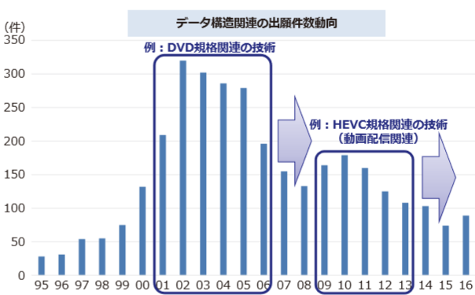
I. Allowable Claim Category
“Information that is to be processed by an electronic computer equivalent to computer programs”
This type of claim is called as a “Data Structure Claim.”
Historically, a data structure claim has been used for protecting DVD specification-related inventions and HEVC specification-related inventions.
# of Applications related to data structure claims
DVD spec.-related inventions
# of Applications
HEVC spec.-related inventions
Movie distribution
JPO Annual Report:
https://www.jpo.go.jp/shiryou/toushin/nenji/nenpou2017/honpen/all.pdf
Year

Slide 11
I. Allowable Claim Category
A data structure claim is lately used for protecting a trained model, comprising a set of node and weight data.
For a data structure claim to be allowable, it must include data structure and description defining processing of a computer.
Example Claim (from Examination Handbook)
[Claim 1] A trained model for causing a computer to function to output …, wherein;
the model is comprised of a first neural network and a second neural network connected in a way …; the said first neural network is comprised of an input layer to intermediate layers …, the number of neurons of the input layer and the number of the output layer are the same, and weights were …; weights of the said second neural network were trained without changing …; and
the model causes the computer to perform a calculation based on the said trained weights in the said first and second neural networks … to output … from the output layer of the said second neural network.
Data Structure
(Configuration
of the model)
Description
defining processing
of a computer

Slide 12
I. Allowable Claim Category
Protecting both learning algorithm used at (i)training phase and a trained model used at the (ii)utilization phase.
A computer program claim is not allowed as a subject matter in the US.
Tips for drafting a claim in Japan
To protect a learning algorithm at the learning phase, a computer program claim should be added as well as a product and a method claim.
To protect a trained model after learning at the utilization phase, a data structure claim, such as a trained model claim, should be added.

Slide 13
Overview
Basics of AI (Machine Learning)
Tips for Protecting AI-Related Invention in Japan
Allowable Claim Category (Subject Matter)
Claims in Accordance with Business Model
System Incorporating a Machine Learning Unit as One of the Claim Elements
Others
Summary

Slide 14
II. Claims in Accordance with Business Model
Machine learning can be implemented on a various network configuration.
Tips for drafting a claim in Japan
In accordance with a network configuration, an applicant should claim individual elements, respectively.
3 Example cases
server
server
server
Learning
Learning
Utilization
request
request
request
・・・
・・・
・・・
・・・
・・・
Learning
Utilization
Utilization
user
user
user

Slide 15
II. Claims in Accordance with Business Model
Tips for drafting a claim in Japan
In accordance with a network configuration, an applicant should claim individual elements, respectively.
Example cases (i)
(i) SaaS (Download Output Data)
- Machine learning is conducted in a server.
- Utilization of a trained model is conducted
in a server
- Only an output is sent to a user’s computer
server
C
Learning
C
Utilization
training data
input data
An applicant should claim, at least:
- a learning system/ utilization system of a trained model
- a learning apparatus/ method
- a utilization apparatus/ method of a trained model
output data
user
© indicates a subject matter to be claimed.

Slide 16
II. Claims in Accordance with Business Model
Tips for drafting a claim in Japan
In accordance with a network configuration, an applicant should claim individual elements, respectively.
Example cases (ii)
(ii) SaaS (Download Trained Models)
server
C
- Machine learning is conducted in a server.
- A trained model is sent to a user’s computer.
- A user can use a trained model at his computer.
Learning
C
training data
An applicant should claim, at least:
- a learning system
- a learning apparatus/ method
- a utilization apparatus/ method of a trained model
- a trained model
Trained model
・・・
・・・
・・・
・・・
・・・
C
Utilization
user
© indicates a subject matter to be claimed.

Slide 17
II. Claims in Accordance with Business Model
Tips for drafting a claim in Japan
In accordance with a network configuration, an applicant should claim individual elements, respectively.
Example cases (iii)
(iii) Download Learning Programs
- Program for learning is downloaded to
a user’s computer
- Machine learning is conducted
in a user’s computer.
- Utilization of a trained model is conducted
in a user’s computer.
server
C
request
Computer program
An applicant should claim, at least:
- a learning apparatus/ method
- a utilization apparatus/ method of a trained model
- a computer program for learning
C
Learning
C
Utilization
user
© indicates a subject matter to be claimed.

Slide 18
Overview
Basics of AI (Machine Learning)
Tips for Protecting AI-Related Invention in Japan
Allowable Claim Category (Subject Matter)
Claims in Accordance with Business Model
System Incorporating a Machine Learning Unit as One of the Claim Elements
Others
Summary

Slide 19
III. System Incorporating a Machine Learning Unit as One of the Claim Elements
AI can be used in any kind of business, and thus machine learning unit is often incorporated as one of the elements of invention.
Tips for drafting a claim in Japan
If machine learning is not an essential feature, it is not recommended to incorporate a machine learning unit as a claim element.
If machine learning is an essential feature but a type of machine learning is not essential, it is one idea to include a phrase of “machine learning” in a claim and support the word in a specification.

Slide 20
III. System Incorporating a Machine Learning Unit as One of the Claim Elements
Example cases (from Examination Handbook Appendix A Case 31)
[Claim 1] A learning system comprising:
a plurality of vehicle onboard devices; and
a server to communicate with the vehicle onboard devices, and
the vehicle onboard device, comprising:
an image recognition unit for …;
a provision unit for providing the server with the image data as learning data;
…
the server, comprising:
...
a learning unit for conducting machine learning and generating data for updating the parameters;
a provision unit for providing the vehicle onboard devices with the data for renewing the parameters.
server
onboard
device
onboard
device
onboard
device

Slide 21
Overview
Basics of AI (Machine Learning)
Tips for Protecting AI-Related Invention in Japan
Allowable Claim Category (Subject Matter)
Claims in Accordance with Business Model
System Incorporating a Machine Learning Unit as One of the Claim Elements
Others
Summary

Slide 22
IV. Others
Protection of Training Data
Entities possessing big data wish to protect their training data per se, not learning algorithm or trained model.
However, it is difficult to protect training data per se because mere showing of data is not protected under the Japanese Patent Law.
Training data is protected only if the training data is structured and the training data defines processing of a computer, which is unfortunately quite rare.
At present, if you wish to protect your training data per se, you are required to rely on technical protection, contractual duties, trade secret under the Unfair Competition Law or Copyright.

Slide 23
IV. Others
Distillation
Distillation is a way of learning with a simple model to extract function from inputs and outputs of a trained model.
It is difficult to prohibit distillation of a trained model under the Japanese Patent Law because learning process is different, a structure of a trained model is different. Also, copyright may not be applicable because expression of a resultant model is different.
At present, if you wish to ban distillation, you are required to rely on technical protection or contractual duties.
model
output
Simpler
Learning
Process
Simpler AI
Trained model
w/ advanced technique
Monitoring Only
Inputs and Outputs
input

Slide 24
Overview
Basics of AI (Machine Learning)
Tips for Protecting AI-Related Invention in Japan
Allowable Claim Category (Subject Matter)
Claims in Accordance with Business Model
System Incorporating a Machine Learning Unit as One of the Claim Elements
Others
Summary

Slide 25
3. Summary
To protect learning algorithm, adding a computer program claim is highly recommended.
To protect a trained model, adding a data structure claim is highly recommended.
A data structure claim must include data structure and description defining processing of a computer.
Claiming a necessary subject matter in accordance with a business model is recommended.
If machine learning is a part of invention, using an abstract phrase such as “machine learning” is one idea.
It is difficult to protect training data per se with a patent.
It is also difficult to ban distillation with a patent.

Slide 26
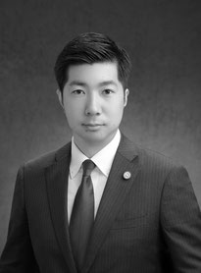
Thank you for your attention
Takeshi Iizuka
takeshi_iizuka@iizuka-ip.com
Iizuka International Patent Office

